Slide 1

Carbon
Forecast
Presenting by Abdulbasit Abdulrazk, Climate Expert

Slide 2

The Climate Challenge
01
CO₂ emissions are driving severe climate impacts globally.
02
Policymakers lack predictive tools to guide their actions.
03
Data-driven forecasts can enhance sustainability planning efforts.

Slide 3
Data & Features
Modeling CO₂ Emissions Variables
Key Dataset
Important Variables
Data Quality
Our World in Data provides a trusted source for a comprehensive dataset, essential for accurate modeling of CO₂ emissions and ensuring data integrity in forecasting efforts.
Key features such as GDP, Energy per Capita, and Population are critical for understanding the dynamics of CO₂ emissions, enabling robust predictions and informed policy-making.
Rigorous data cleaning processes ensure quality and consistency in the dataset, enhancing the reliability of the model outputs and supporting actionable insights for climate action initiatives.

Slide 4
Model & Approach
Using Random Forest for Predictions
Model Selection
Data Splitting
Evaluation Metrics
We chose the Random Forest Regressor due to its ability to handle complex relationships within data, ensuring robust predictions for CO₂ emissions based on diverse input features.
The dataset was divided into 80% training and 20% testing segments, allowing us to effectively validate the model's performance and ensure its reliability in real-world applications.
We utilized metrics such as MAE, RMSE, and R² to assess prediction accuracy, highlighting the model's reliability and providing valuable insights into its effectiveness in forecasting emissions.

Slide 5
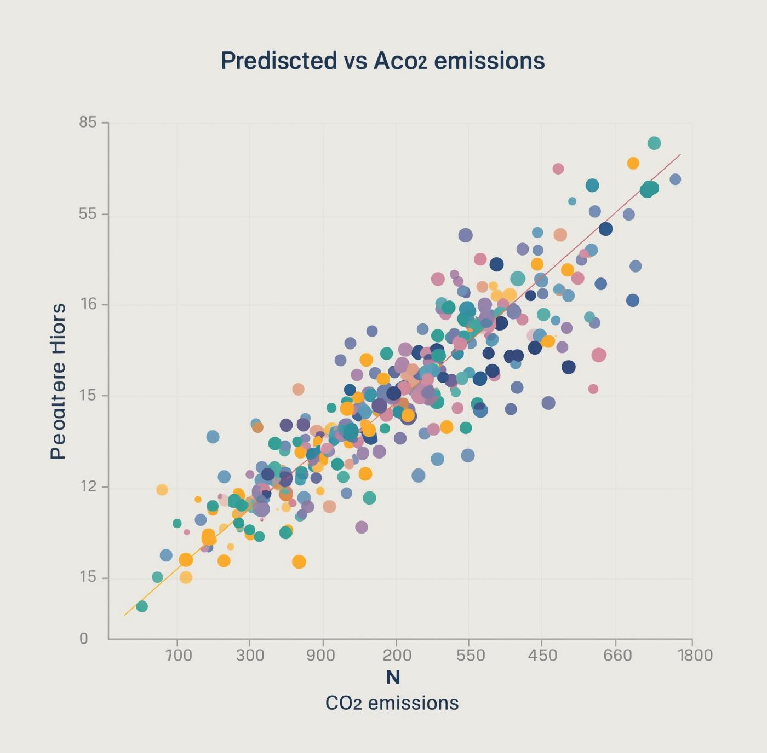
Key Results
Our model demonstrates impressive predictive performance with an R² of 0.99, indicating high accuracy in forecasting CO₂ emissions. The metrics verify its reliability, allowing policymakers to make informed decisions and implement effective climate action measures.

Slide 6
Ethics and Limitations
Data Gaps
Significant data gaps exist, especially in developing countries, impacting the model's accuracy and reliability.
Reporting Bias
Reporting bias may affect emissions data quality, necessitating careful interpretation and enhancement of transparency in findings.

Slide 7

Contact Us
Join us in making a difference in climate action.
Phone: +2349068360557
Email: Abdulrazakabdulbasit19@gmail.com
Website: https://github.com/CaptainTyborg/

